Slide 1


Prediction Of Stock Market Price With The Help Of Deep Learning
BY TEAM 17
AYUSH (RA1911026020023)
ANANT (RA1911026020034)
SOHAM (RA1911026020054)

Slide 2

TITLE EXPLANATION
Stock marketplace is characterized as dynamic, unpredictable, and non-linear in nature.
Stock marketplace prediction is the technique of determining the destiny cost of an inventory of an organization on an exchange. Its prediction and evaluation are a number of the maximum hard jobs to complete.
There are several reasons for this, together with marketplace volatility and quite a few different structured and unbiased variables that impact the fee of a positive inventory withinside the marketplace.
However, with the creation of Machine Learning and its robust algorithms, most of the latest marketplace studies and Stock Market Prediction improvements have started to encompass such methods in studying inventory marketplace data.

Slide 3
DOMAIN EXPLANATION
Machine learning is a department of Artificial intelligence (AI) and computer technology that makes a specialty of using statistics and algorithms to mimic the manner that human beings learn, steadily enhancing its accuracy.
Deep learning is a subset of machine learning in which artificial neural networks, which are inspired by the human brain, learn from massive amounts of data.
Deep Learning can be supervised, semi-supervised, or unsupervised.
We call it 'deep learning' because neural networks have multiple (deep) layers that allow for learning. Deep learning can learn to solve virtually any problem that requires "thought" to solve.

Slide 4
ABSTRACT
Accurate prediction of stock marketplace returns is a totally difficult challenge because of the unstable and non-linear nature of the economic stock markets.
With the creation of artificial intelligence and Machine learning, programming techniques of prediction have proved to be extra efficient in predicting stock prices.
The primary goal of this work is to create a stock price predictor that will forecast future prices using a dataset that comprises past stock prices for numerous companies.
According to the NASDAQ, our desired stock price information will be delivered in the form of a Comma Separated File (.csv), which can be accessed and studied in Excel or a Spreadsheet.
The stock is traded on the NASDAQ exchange, and its value is updated every business day. It is important to note that the market is closed on Saturdays and Sundays, therefore there is a gap between the two dates. For each day, the stock's Opening Value, Highest and Lowest values on the same days, as well as the Closing Value at the end of the day, are all shown.

Slide 5
OBJECTIVE
The stock market is one of the most rapidly developing sectors in any country. Many people are now involved in this industry, either indirectly or directly.
As a result, understanding market trends becomes critical. As a result, individuals are interested in stock price predictions as the stock market develops.
One of a trader's key goals is to predict the stock price so that he can sell it before it drops in value or acquire it before it rises in value.
The efficient market hypothesis asserts that stock prices cannot be predicted and that stock prices follow a random walk
. It appears to be quite difficult to substitute an experienced trader's professionalism in anticipating stock prices.
So as stated in the earlier slides, the primary goal of this work is to create a stock price predictor that will forecast future prices using a dataset that comprises past stock prices for numerous companies.

Slide 6
EXISTING SYSTEM
Some algorithms and models that were used previously in this area:
Random Walk Theory (RWT)
Moving Average Convergence / Divergence (MACD)
Autoregressive Moving Average (ARMA)
Autoregressive Integrated Moving Average (ARIMA)
Support Vector Machine (SVM)
Random Forest (RF)

Slide 7
DISADVANTAGES
Classic regression methods like linear regression, polynomial regression, SVM, and others were formerly employed to forecast stock trends that are outdated.
Due to the availability of different NNs (Neural Networks) such as ANN, RNN, DNN, etc. more methods of predicting stocks are now available.

Slide 8
PROPOSED SYSTEM
As stated earlier, we will get our data from NASDAQ about our desired stock price which will be delivered in the form of a Comma Separated File (.csv), which can be accessed and studied in Excel or a Spreadsheet.
Thestock is traded on the NASDAQ exchange, and its value is updated every business day. It is important to note that the market is closed on Saturdays and Sundays, therefore there is a gap between the two dates. For each day, the stock's Opening Value, Highest and Lowest values on the same days, as well as the Closing Value at the end of the day, are all shown.
We will develop a deep Learning model to forecast the prices using the Long Short-Term Memory (LSTM) approach. By multiplying and adding, they are utilized to make minimal modifications to the data.
Long-term memory (LSTM) is a recurrent neural network (RNN) architecture used in deep learning.

Slide 9
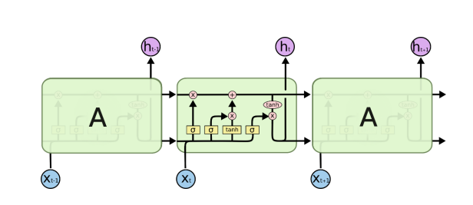
LSTM ARCHITECTURE

Slide 10
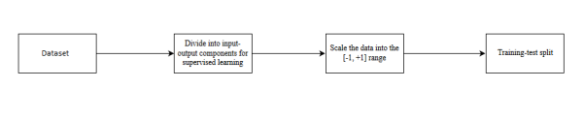
SYSTEM ARCHITECTURE
Pre-processing of data

Slide 11
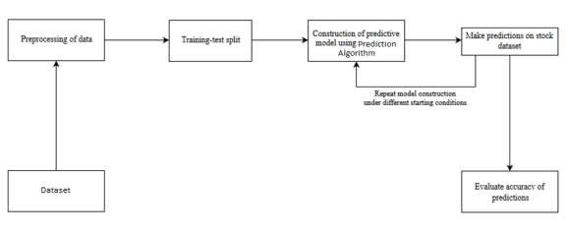
SYSTEM ARCHITECTURE
Overall Architecture

Slide 12
ADVANTAGES
When compared to previous models such as SVM, LTSM outperforms SVM in every circumstance. This is due to its superior capacity to remember and forget data compared to SVM.
LSTM has feedback connections, unlike standard feed-forward neural networks. It can handle both single data points (like photos) and entire data sequences (such as speech or video).

Slide 13
HARDWARE AND SOFTWARE REQUIREMENTS
RAM: 8GB
GPU: GTX 1650Ti
CPU : (Any one of the following )
AMD Epic 64 Cores 128 Threads (preferred)
AMD Thread Ripper
I7 12Gen Octa Core 16 Threads
Motherboard: ASUS ROG B450-F AMD AM4 Socket
Cooling Technology: NZXT X63 280mm All-in-one Liquid CPU Cooler
OS: Windows 11 professional / LINUX
Network: 100 Mbit/s
Software:
Microsoft Visual C++ 2015 Redistributable Package Update 3 (x64)
Microsoft® .NET Framework Version 4.7.1 (Win 7, Win 8.1, Win 10)
Visual Studio Code

Slide 14

WHAT IS THE INNOVATION OUR APPLICATION?
The results show a good performance, implying that with the current technology of AI, it is safe to claim AI can beat the stock markets.

Slide 15
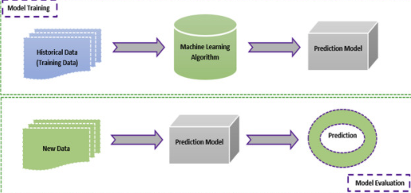
WHAT IS THE INNOVATION OUR APPLICATION?

Slide 16
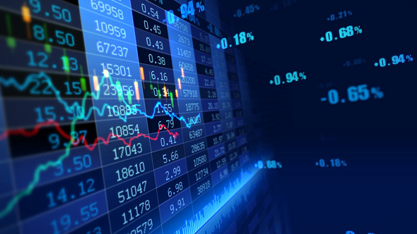
THANKS FOR YOUR TIME
AYUSH (RA1911026020023)
ANANT (RA1911026020034)
SOHAM (RA1911026020054)

